Slide 1
Colloquial Expressions Detection Using Machine and Deep Learning Techniques
Mahir Faisal Chowdhury
Id: 19301026
Course: CSE431
Section: 1
St: Farah Binta Haque
Ra: Humaion Kabir Mehedi
Submitted to -
Annajiat Alim Rasel
‹#›

Slide 2
Paper Title:
Food for Thought: How can we exploit contextual embeddings in the translation of idiomatic expressions?
Paper Link: 10.18653/v1/2022.flp-1.14

Slide 3
Introduction
Aim to improve translations by contextual embeddings
Took two different approaches to fine tune the transformer model
First, translate sentences from english to german
Then, paraphrase the translated idiom sentences
They are the first to do translate idioms of one language to another

Slide 4
Related Works
Bert, Bart and T5 transformer models performed on many NLP tasks but idioms translation was different
Some researches happened on idioms translations and paraphrasing using Bart
PIE dataset is the best as it has both idioms and non-idioms
NMT and SMT are models trained idiomatic expression datasets

Slide 5
Methods
Two approaches:
Idioms translations English to German
Used T5-small implementations of 60 millions parameters to train
Paraphrase the translated text
Idioms to idioms translation
Idioms paraphrasing and translation
Dataset, Data cleaning, Model training, translation
Dataset: 3498 sentence pairs distributed to 1998 and 1500 sentence pair.
Data Cleaning: for having miss-translation from german to english, they plan to eliminate noise and reduced train and test datasets by 13.3% and 15.2%
Model Training: fine tuned for translation task using cleansed IdiomTranslationDS dataset
Needed 50 epochs to fine tuned the model

Slide 6

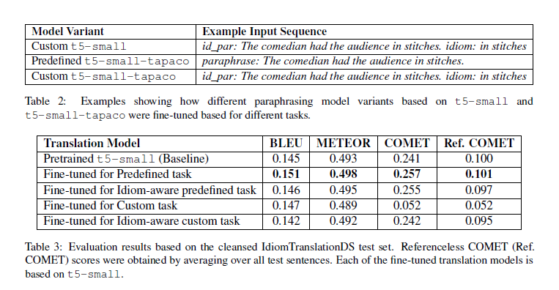
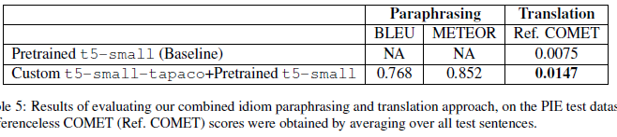
Results

Slide 7
Future Work
Further exploration of transformer models and contextual embeddings for idiomatic expression translation in different languages and translation directions.
Expanding the available parallel corpora to include a wider range of idiomatic expressions for more comprehensive analysis.

Slide 8
Conclusion
The study demonstrates the potential of transformer models, specifically T5, in improving the translation of idiomatic expressions.
The findings highlight the importance of considering contextual embeddings in addressing the challenges of idiomatic expression translation.
Further research is needed to enhance the accuracy and generalizability of idiomatic translation models and expand their application to different languages and domains.

